Slide 1
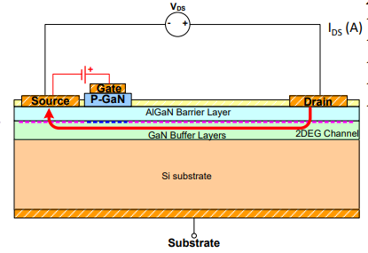
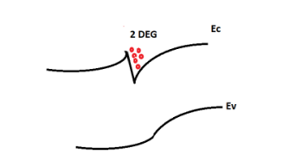

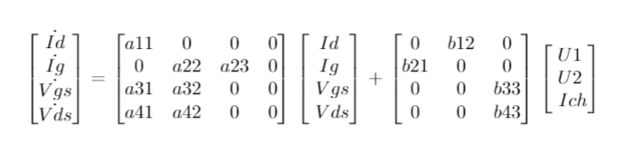
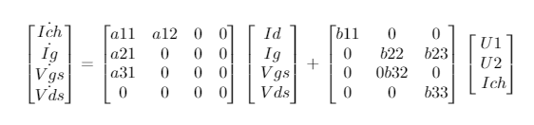
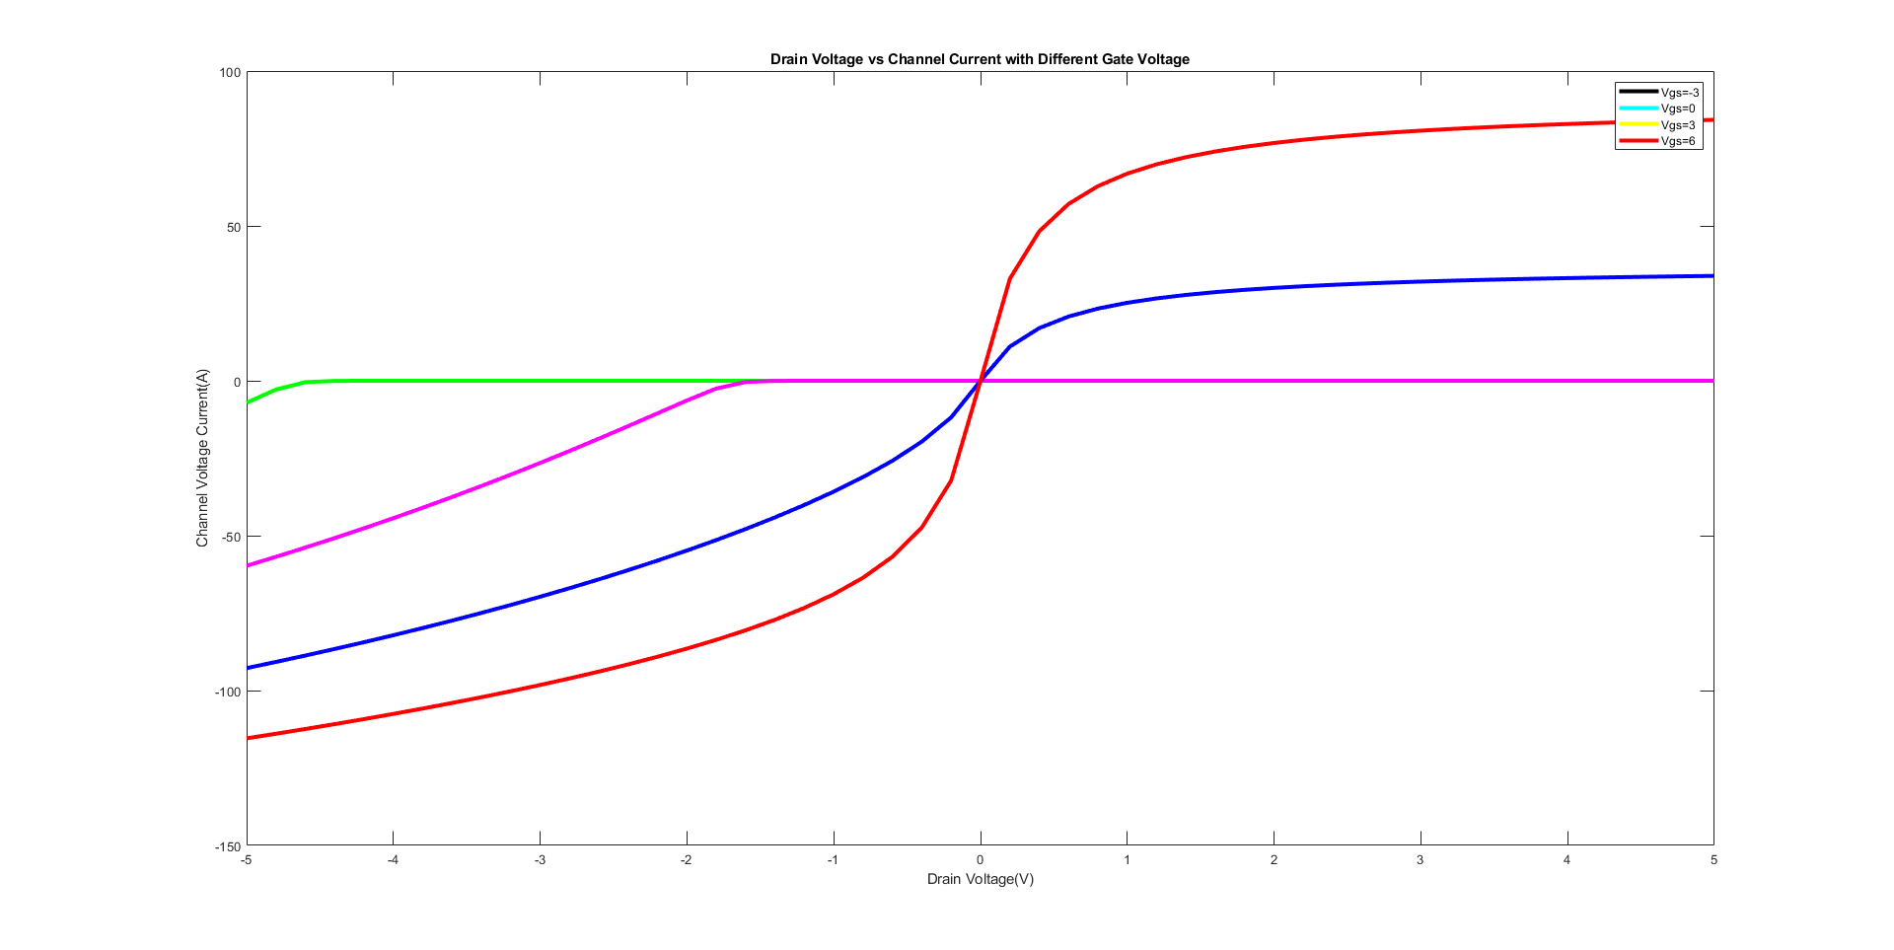
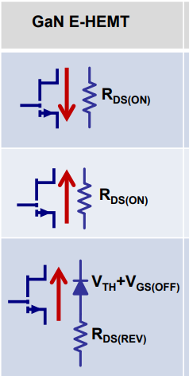
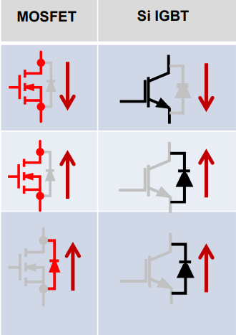
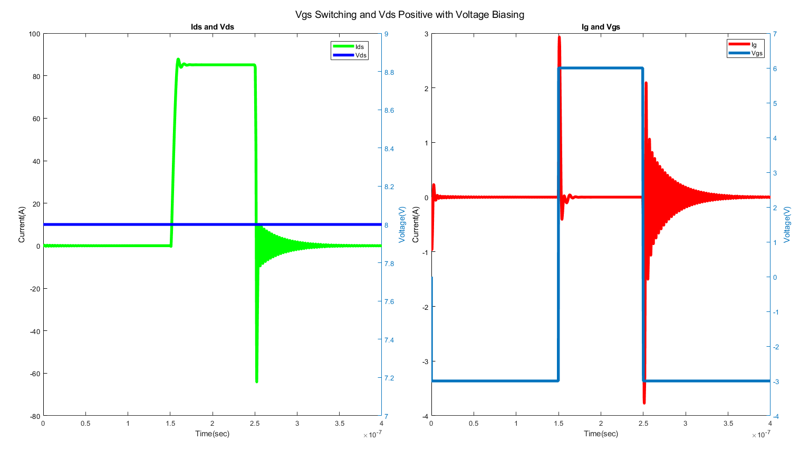
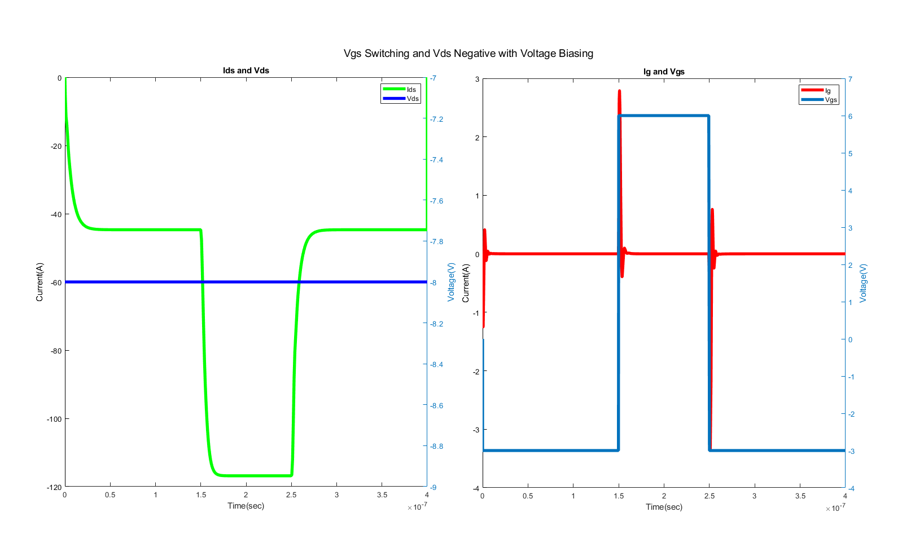
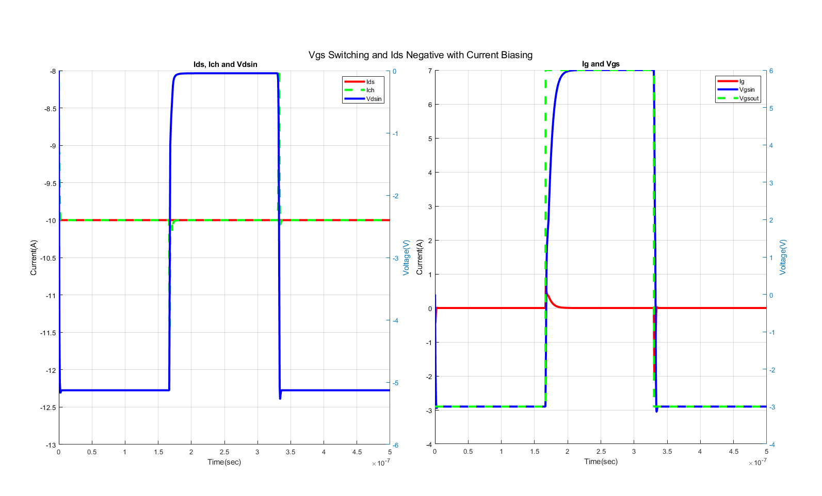
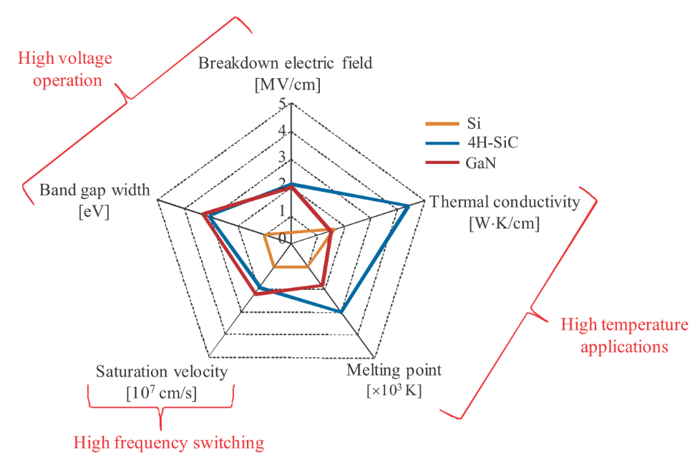
State-Space Modelling of the Gallium-Nitride Based Power Transistors
Enes Ayaz
(enes.ayaz@metu.edu.tr)
Ozan Keysan
(keysan@metu.edu.tr)
PowerLab Research Group, METU, ANKARA
Abstract
Electrical Model of GaN HEMTs
Nowadays, Gallium Nitride which is a type of high electron mobility transistor become more popular than its rivals such as SiC and IGBT in power applications. GaN provides some advantages such as high switching frequency, reverse current capability and high efficiency to its counterparts. However, electrical and mathematical modelling of GaN for simulation environments are insufficient because of its bleeding-edge technology. Also, the electrical model of GaN takes more time while using the simulation because of the complexity of dynamic behaviours. In this study, the electrical model of GaN is converted to mathematical model to minimize the simulation time and to reach the same resolution and accuracy as at the electrical model. The mathematical model is created by using State Space Realization.
The electrical model of GaN consists of voltage dependent current source, capacitance, inductances and resistance. The voltage dependent current source reflects the main occurrence of current at channel with respect to inner gate-source and drain-source voltages. The capacitances are important at transient state, it determines the dynamic behaviour of the GaN. The inductances represent unintended inductances, stray inductances which disrupt the current flow.
GaN HEMTs Physical Structure
State Space Model of GaN HEMTs
The State-Space model is created by using the electrical modelling of GaN. The state space model can be stated as:
As mentioned earlier, Gallium Nitride is a type of high electron mobility transistors. The main advantages of the HEMTs over the MOSFETs are high electron velocity and high breakdown electric field.
A quantum well is formed at the contact between large band gap material and low band gap material and it can be named as two-dimensional electron gas (2DEG) cloud. Thus, the electrons are apart from impurity and mobility of electrons increases.
Next state is determined by using current state and current input. Inputs, states and output can be chosen in different combinations. We create two state space model based on the excitation types. One of them is excited by current and other one is excited by voltage. Also, state and input matrices are function of the capacitance, inductance and resistance at electrical model. The capacitance and channel current are calculated with respect to channel voltage and inner gate-source voltage at every step of solution.
Operational Points
Voltage Excitation Current Excitation
Simulation Results
GaN HEMT has no body diodes externally, but 2DEG provide 3rd quadrant. It can conduct in forward current during positive gate-source voltage. Also, it can conduct in reverse current at both gate-source voltage positive and negative. However, the more negative gate-source voltage increases the drain-source voltage and increases the power loss.
Advantages of GaN HEMTs
High Electron Mobility
Higher Gain
Small Package
Lower Parasitic Elements
Lower Noise
Higher Switching Frequency
Higher Efficiency
Small On-Resistance
Lower Conduction Loss
Higher Transconductance
Conclusion
In this study, GaN HEMT is investigated considering physical structure and operation regions. Advanteges of the GaN HEMT over the counterparts such as SiC and Silicon based IGBT are argued with respect to voltage ratings, switching frequencies and termal situation. The electrical model of the GaN is converted to mathematical model by using State Space Realization. The dynamic characters of the State Space model are simulated by using MATLAB. The mathematical model is verified after comparing it with the electrical model.
References
[1] J. Kovac, R.Szobolovszky, A.Kosa, A.Chavala, J.Marek, L.Stuchlikova , GaN/SiC based High Electron Mobility Transistors for integrated microwave and power circuits, Institute of Electronics and Photonics, Ilkovičova 3, 812 19, Bratislava, 2015
.[2]GaN Systems, “GS66508B Design with GaN Enhancement mode HEMT,” pp. 1–46, 2018.

